Slide 1
MOLECULAR BIOLOGY LABORATORY
BT 453
Laboratory No. 8
DNA Sequencing
MBL. BT453

Slide 2
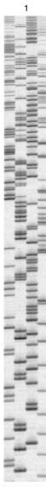
DNA Sequencing
DNA Sequencing
The determination of the precise sequence of nucleotides in a sample of DNA.
There are two methods that were commonly used to
sequence DNA:
Sanger Method – dideoxy method
Maxam-Gilbert Method – chemical degradation method
Automated Cycle Sequencing – dideoxy method
MBL. BT453
www.epibio.com/f4_2/f4_2sx2.jpg

Slide 3

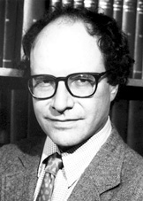
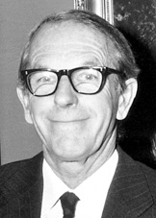
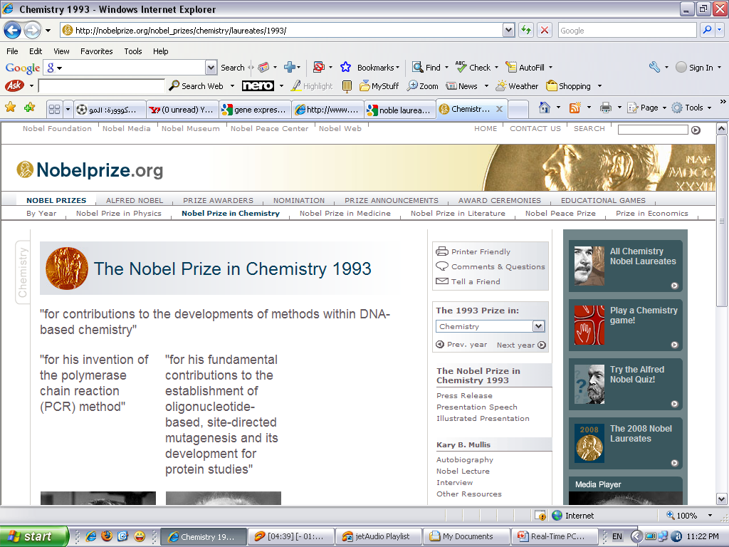
The Nobel Prize in Chemistry 1993
The Nobel Prize in Chemistry 1993
for their discoveries concerning the interaction between tumour viruses and the genetic material of the cell"
DNA sequencing was made easy by
Walter Gilbert | Frederick Sanger
The Nobel Prize in Chemistry 1980
MBL. BT453

Slide 4
Sanger Method
In-vitro DNA synthesis using ‘terminators’, use of dideoxi- nucleotides that do not permit chain elongation after their integration
DNA synthesis using deoxy- and dideoxynucleotides that results in termination of synthesis at specific nucleotides
Requires a primer, DNA polymerase, a template, a mixture of nucleotides, and detection system
Incorporation of di-deoxynucleotides into growing strand terminates synthesis
Synthesized strand sizes are determined for each di-deoxynucleotide by using gel or capillary electrophoresis
Enzymatic methods
MBL
MBL
MBL. BT453
MBL

Slide 5
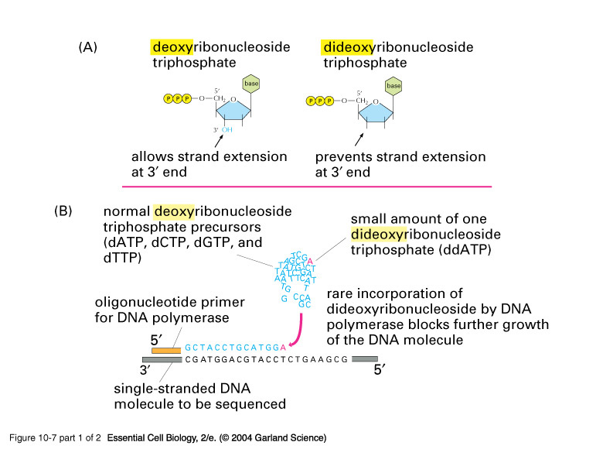
Sanger Method
MBL
MBL. BT453
MBL
Notes:
10_07_1_enzym.dideoxy.jpg

Slide 6
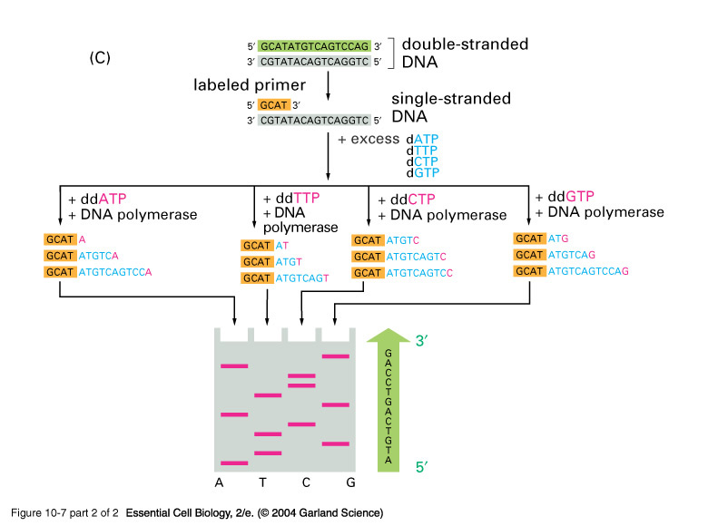
Sanger Method
MBL
MBL. BT453
MBL
Notes:
10_07_2_enzym.dideoxy.jpg

Slide 7
Automated Cycle Sequencing
Strand Separation
Primer annealing/extension cycles
Chain termination
Gel electophoresis
Data analysis
MBL. BT453
MBL

Slide 8
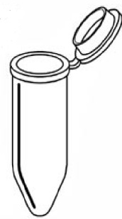


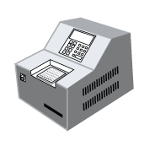
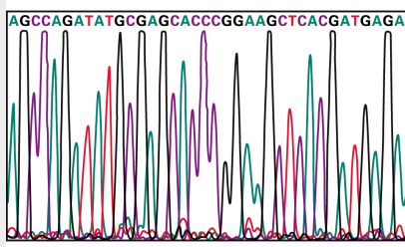
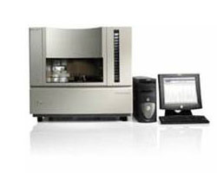
Automated Cycle Sequencing
2. Set up sequencing reaction
1. Purify PCR product
3. Perform cycle sequencing
4. Resolve sequence fragments
5. Read order of terminators
(DNA sequence)
MBL. BT453

Slide 9
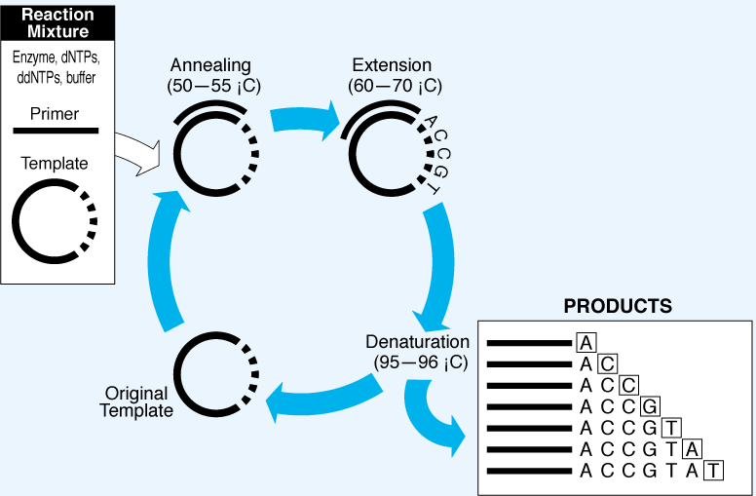
Automated Cycle Sequencing
MBL. BT453
MBL

Slide 10
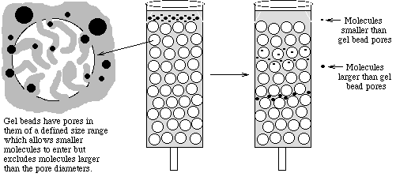
Clean-up of Sequencing reactions
Gel Filtration
Excess reaction constitutes
Large DNA fragments
MBL
MBL. BT453
MBL

Slide 11
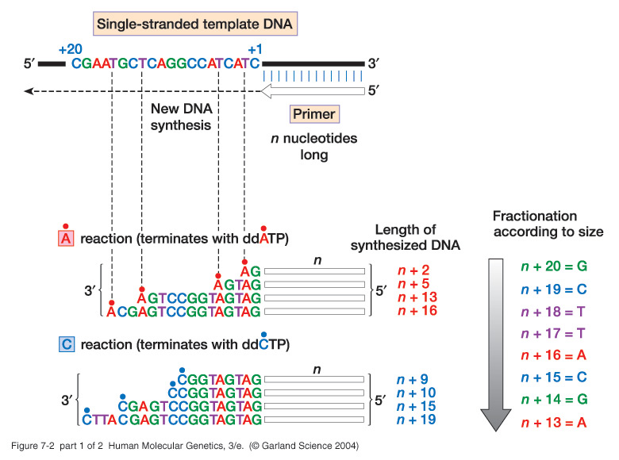
Automated Cycle Sequencing
MBL. BT453
MBL
Notes:
07_02.jpg

Slide 12
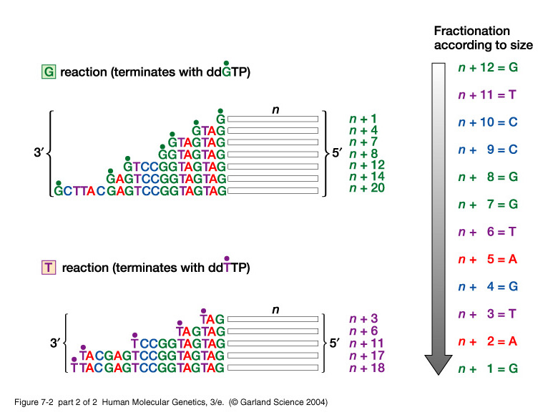
Automated Cycle Sequencing
MBL. BT453
MBL
Notes:
07_02_2.jpg

Slide 13
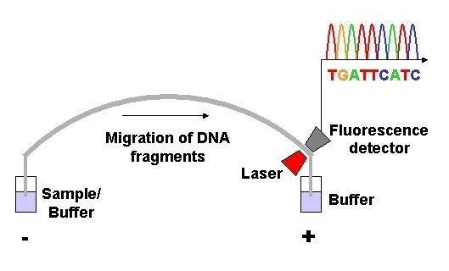
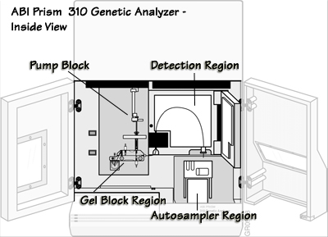
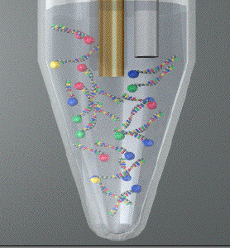
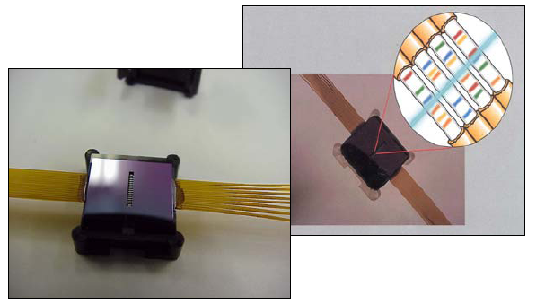
Cycle Sequencers
Sequencing reaction products
Capillaries
Cathode
Capillaries
MBL. BT453

Slide 14
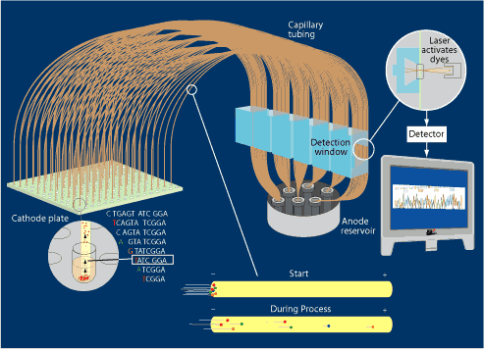
Cycle Sequencers (96 capillaries)
e.g. ABI 3730
POP-4 or POP-6 polymer
+
Electrophoresis Buffer
MBL. BT453

Slide 15
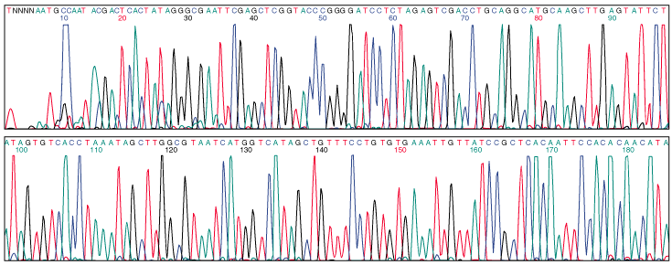
Chromatograms
MBL. BT453
MBL
Notes:
The computer displays the information received from the photocell as an electropherogram, which is a tracing of signal received by the photodetector in each of the four wavelengths.
Although the real colors seen by the photodetector are close to green, yellow, orange and red, the computer assigns false colors to each of the four tracings to make it easier to tell them apart. It also prints the letter of the appropriate base below each of the signal peaks.
Because successive peaks correspond to DNA segments differing in length by one nucleotide, the sequence of peaks reveals the sequence of bases in the original DNA sample.

